Slide 1
Java Unit Testing With Mockito Tips And Tricks
Michael Plüss
Michael Plüss

Slide 2
GitHub
https://github.com/ERNICommunity/java-circle-test-mocking
Recommended to use IntelliJ

Slide 3



Technologies
Junit 5
Mockito
Spring

Slide 4
Structure
Techniques:
@Injectmocks
MockedStatic
Spy
@ParametrizedTest
Previews of additional techniques
AssumeThat
Extracting
Each technique:
Short description
Exercise
5 minutes discussion

Slide 5
@InjectMocks
Issues:
Lots of testing constants
Scrolling between constants, tests and mocked services
Solution:
Mock services via @InjectMocks and @Mock
Mock service methods in test method

Slide 6
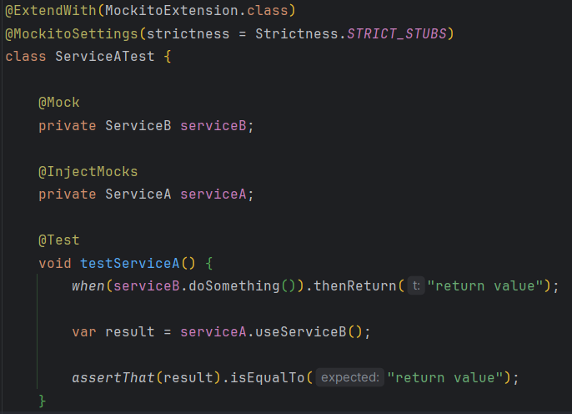
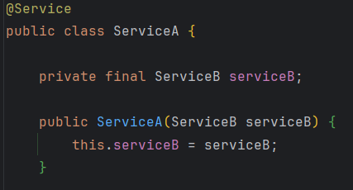
@InjectMocks
Refactor “InjectMocksServiceTest”

Slide 7
@InjectMocks – 5 min discussion
How do you feel about this approach?
Advantages?
Disadvantages?
Alternatives?

Slide 8
MockedStatic
Issues:
Service uses static method (e.g. LocalDateTime.now() )
Solution:
Static methods can be mocked!

Slide 9
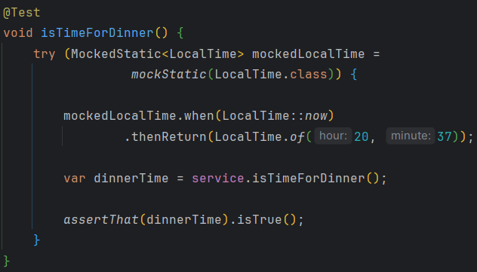
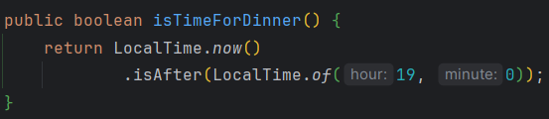
MockedStatic
Refactor “UsesStaticServiceTest”

Slide 10
MockedStatic – 5 min discussion
How do you feel about this approach?
Advantages?
Disadvantages?
Alternatives?

Slide 11
Spy
Issues:
How to test an interface with default methods?
Solution:
Mockito.spy() allows us to test interfaces without implementation

Slide 12
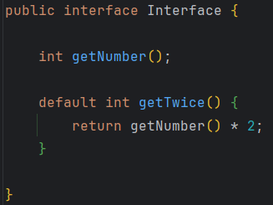
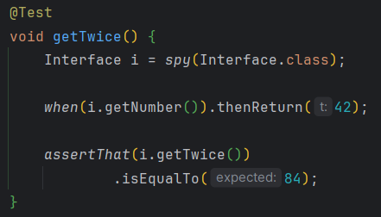
Spy
Refactor “HasHelloInterfaceTest”

Slide 13
Spy – 5 min discussion
How do you feel about this approach?
Advantages?
Disadvantages?
Alternatives?

Slide 14
@ParameterizedTest
Issues:
Method takes a number of parameters
We need to test many different combinations
Solution:
The “table” of parameters and corresponding expected results can be extracted
Separate data and test logic

Slide 15
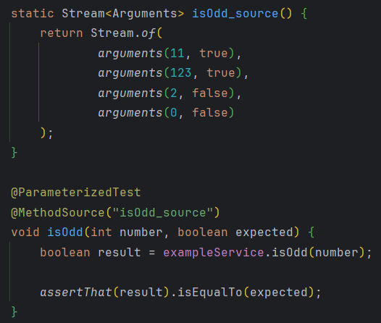
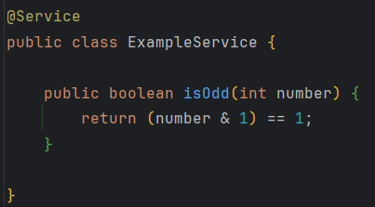
@ParameterizedTest
Refactor “PocketCalculatorTest”

Slide 16
@ParameterizedTest – 5 min discussion
How do you feel about this approach?
Advantages?
Disadvantages?
Alternatives?

Slide 17
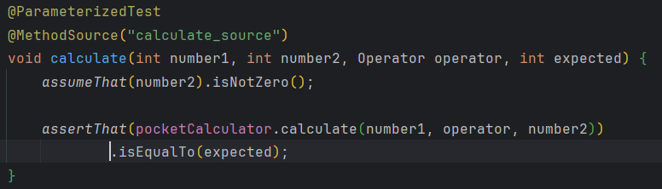
Further Techniques: AssumeThat
Only run a test, if an assumption is fulfilled
Ensure that a generalized test only tests data that makes sense in its context

Slide 18
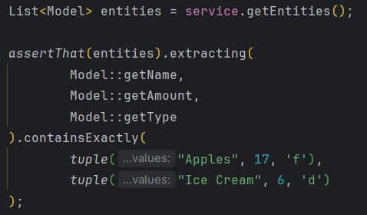
Further Techniques: Extracting
Test various fields at once
Compact testing of lists

Slide 19
Questions & Feedback
& Thank you!

